Slide 1

Project Commercial & Demo
Nidhi Saseendran
200436457

Slide 2
Goal 7: Affordable & Clean Energy

Slide 3
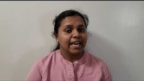
Project Commercial

Slide 4
Project Demo

Slide 5
Project Reflection
What went good
Learned a new technology(WordPress)
Went deeper to learn about energy efficiency
devices, its benefits and how to save energy
What not went well:
Lost all data
Redone everything within a week
Categories & tags created but not worked
Same on future projects:
Follow the same Project planning ideas
Differently on future projects:
Better project design

Slide 6
Thank you

